Slide 1



Date: 20-06-25

Slide 2


Subodha Platform
Qwerty Keyboard
Unlock The Computer
File Explorer App
Dialog Window
Introduction To Internet
1
2
3
4
5
6
7
8
9
Power On
Desktop window
Multi Tasking
Create, Read And Write Simple Text

Slide 3


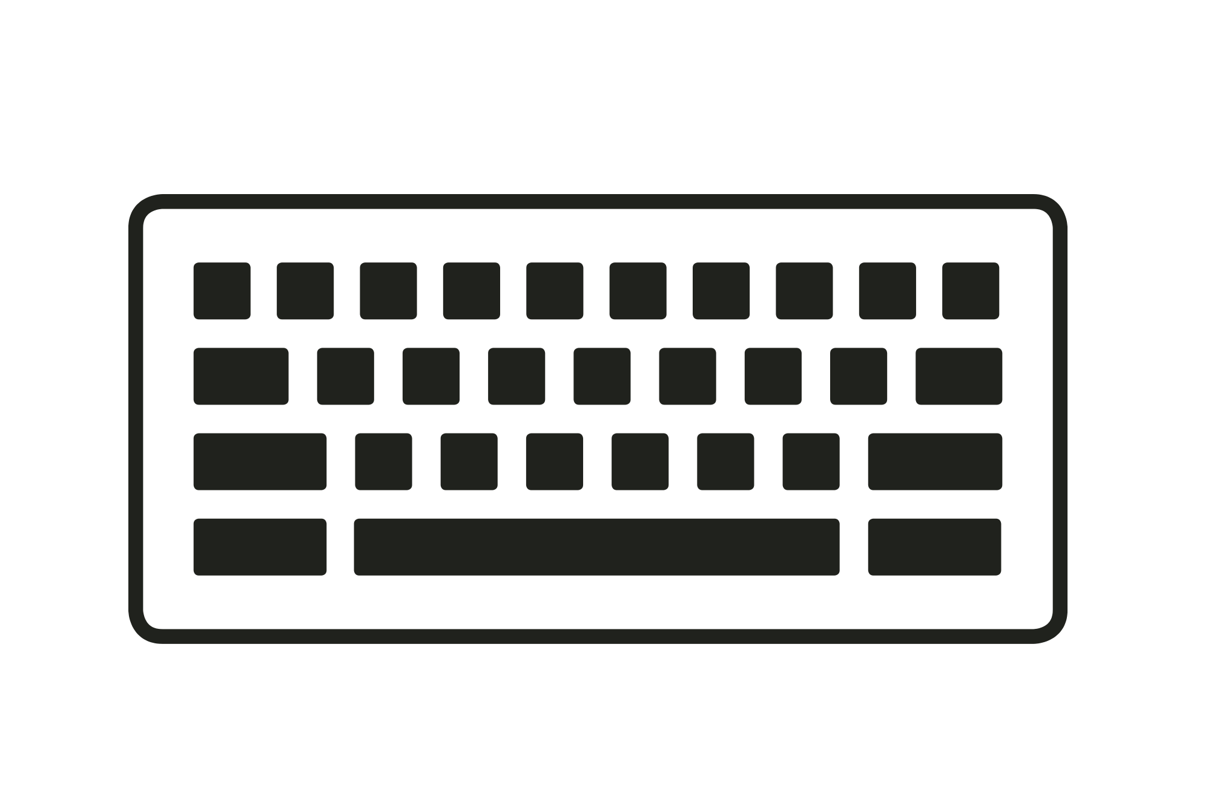

Major Parts
1
2
3
4
MONITOR
CPU
KEYBOARD
SPEAKER
A screen that shows what the computer is doing. It looks like a TV and displays pictures, text, and videos.
The Central Processing Unit is the brain of the computer. It processes instructions and stores data.
A flat board with many buttons called keys. You press the keys to type letters, numbers, and give commands to the computer.
A device that produces sound from the computer. You can hear music, voices, or other sounds through it.
Additional: UPS (Uninterruptable Power supply), Headphone

Slide 4
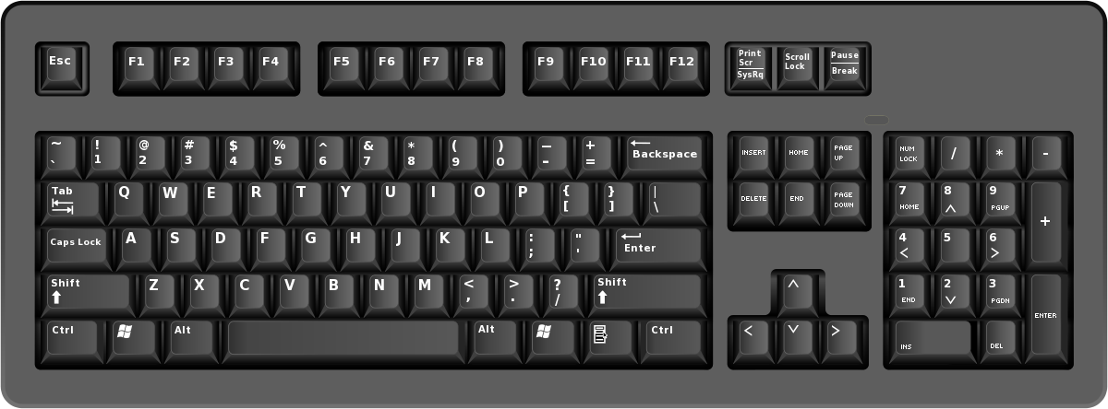
Module 1: Qwerty Keyboard

Slide 5
Module 1: Qwerty Keyboard
A QWERTY keyboard is the most common keyboard layout used in computers and laptops.
The name “QWERTY” comes from the first six letters on the top row of alphabet keys: Q – W – E – R – T – Y
It includes 6 rows

Slide 6

Types of Keys
1
Special Keys
2
Function Keys
3
Number Keys
4
Alphabets Keys
5
Symbol Keys
6
Navigation Keys
7
Calculation Keys

Slide 7
Special Keys
ESC( Escape Key)
The ESC key lets you stop or cancel what you are doing on the computer. It is usually at the top-left corner of the keyboard.
Example:
Imagine you accidentally opened a menu or a help box on the computer, and you don’t want it. You can press the ESC key, and the menu or box will close immediately.
If a screen reader starts reading a long message or pop-up, and you want to stop it quickly, press the ESC key.

Slide 8
Special Keys
Tab Key
The word “Tab” stands for “Tabulate”, which means to move the cursor to a fixed distance or position.
Example:
The Tab key helps in navigating quickly between items without using a mouse.
Move the cursor forward by a set space (usually 4–8 spaces).
Use Shift + Tab to move backward.

Slide 9
Special Keys
Caps Lock Key
The name “Caps Lock” means "Capital Letters Lock.“
Example:
When Caps Lock is ON, all letters you type will be in capital letters (A, B, C, ...).
When Caps Lock is OFF, letters will be small or lowercase (a, b, c, ...).
It does not affect number keys or special characters (like @, #, $, etc.).

Slide 10
Special Keys
Shift Key
It is used to temporarily change the function of another key.
Example:
Press Shift + letter to get a capital letter, like: Shift + a = A
Press Shift + number keys to get symbols: Shift + 1 = !
Press Shift + arrow key to select text.

Slide 11
Special Keys
Ctrl Key
Ctrl stands for Control. By itself, the Ctrl key does nothing, but when you press it along with other keys, it performs special commands.
Example:
Ctrl + C = Copy
Ctrl + V = Paste
Ctrl + Z = Undo

Slide 12
Special Keys
Windows Key
The Windows key is a special key that opens the Start menu in Windows operating systems.
You can press it alone or with other keys for quick commands:
Win + E = Open File Explorer
Win + M = Minimize all windows
Win + V = Open Clipboard

Slide 13
Special Keys
Alt Key
Alt stands for "Alternate". It is used to perform alternate functions of other keys when pressed together.
Example:
Alt + F4 = Close The Window
Alt + Tab = Switch between open applications
Alt + Space = Switch between open applications

Slide 14
Special Keys
Space Key
The Space key (or spacebar) is the longest key on the keyboard. When you press the Space key, it adds a blank space between words or characters.
Play or pause In media players (like YouTube or VLC)

Slide 15
Special Keys
Menu & Enter & Backspace
The Menu key opens the context menu — the same menu you get when you right-click with a mouse.
When typing, pressing Enter Key creates a new line (you will hear a screen reader say “blank” or "new line"). Enter is used to click or open the selected item.
The Backspace key deletes the character to the left of the cursor.

Slide 16
Function Keys
Function Keys
F1 | Opens Help in most programs
F2 | Renames a selected file or folder
F3 | Opens search feature in File Explorer or browser
F4 | Alt + F4 closes the current window
F5 | Refreshes a page (browser, folder)
F6 | Moves the cursor to the address bar in browser
F7 | Starts spell check in MS Word
F8 | Used to enter Safe Mode in older Windows
F9 | Refreshes a document in MS Word
F10 | Activates menu bar in some programs
F11 | Switches to full-screen mode in browsers
F12 | Opens Save As window in MS Word
Function Keys are the keys labeled F1 to F12 on the top row of the keyboard.
They perform special actions depending on the software or app you're using.

Slide 17
Number Keys
Number Keys
Number keys are the keys used to type numerals (0 to 9) on the keyboard.
Also shares keys with symbols, typed using Shift.

Slide 18
Alphabet Keys
Alphabet Keys
Alphabet keys are the 26 letter keys on the keyboard (A-Z).
Layout:
Q W E R T Y U I O P
A S D F G H J K L
Z X C V B N M

Slide 19
Symbol Keys
Key Pressed | Symbol Typed
- | - (hyphen)
= | = (equal sign)
[ | [
] | ]
; | ;
' | ' (apostrophe)
, | , (comma)
/ | / (slash)
\ | \ (backslash)
Shift + any of above | Other symbols (e.g., {, }, :, ", <, >, ?)

Slide 20
Navigation Keys
Top Row:
Print Screen (PrtSc) – Captures a screenshot of the entire screen.
Scroll Lock – Rarely used; in some programs, it locks the scrolling of text.
Pause/Break – Used to pause operations.(used by programmers, it can halt the code temporarily.)
Middle Block:
Insert – Switches between inserting and overwriting text.
Home – Moves the cursor to the beginning of a line.
Page Up – Scrolls up one page in documents.
Delete – Deletes the character after the cursor.
End – Moves the cursor to the end of a line.
Page Down – Scrolls down one page in documents.
Bottom Block (Arrow Keys):
Up Arrow (↑) – Moves the cursor or selection up.
Down Arrow (↓) – Moves the cursor or selection down.
Left Arrow (←) – Moves the cursor or selection left.
Right Arrow (→) – Moves the cursor or selection right.

Slide 21
Calculation Keys
Calculation Keys
Num Lock – Turns the number pad on/off (enables number input when ON).
0 (Ins) – Number 0 / Insert key when Num Lock is off.
. (Del) – Decimal point / Delete key when Num Lock is off.

Slide 22
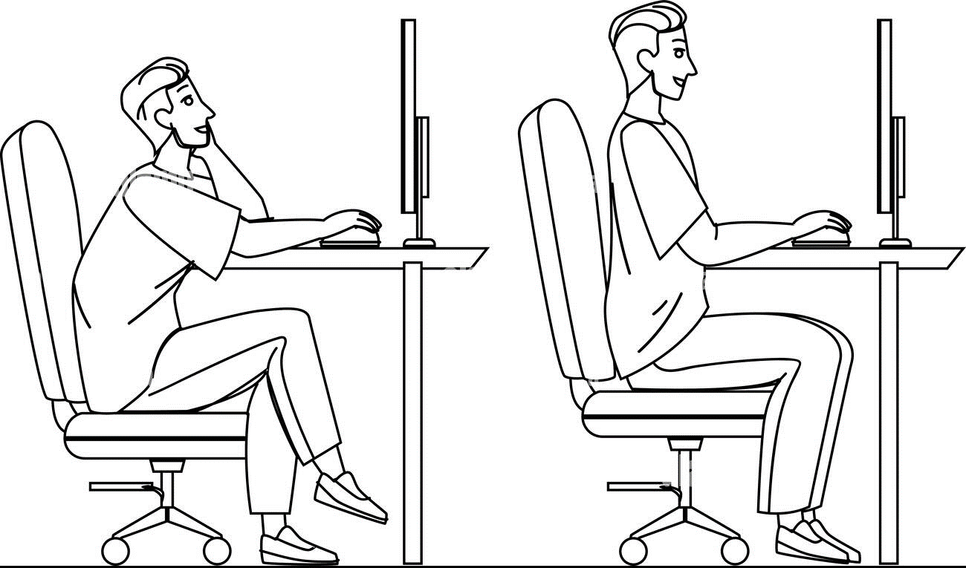


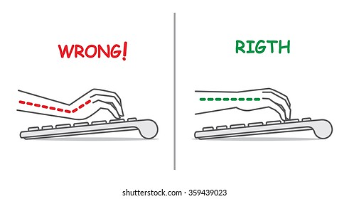
Correct Body Posture
Aspect | ❌ Bad Posture | ✅ Good Posture
Back | Bent, no support | Straight and fully supported
Head | Bent forward | Head straight and relaxed
Wrists | Bent or angled | Straight and aligned with forearm
Elbows | Awkward or raised | Relaxed, 90° angle
Legs/Feet | Crossed or unsupported | Feet flat on floor
Impact | Leads to pain and fatigue | Promotes comfort and focus

Slide 23
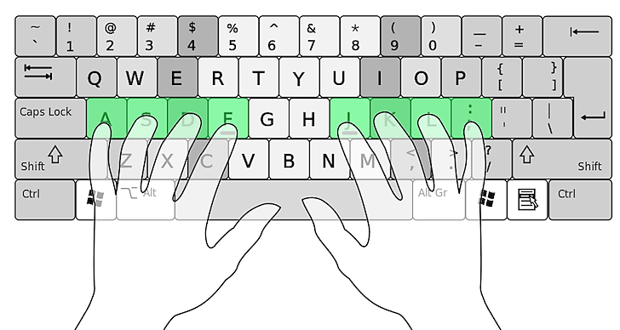
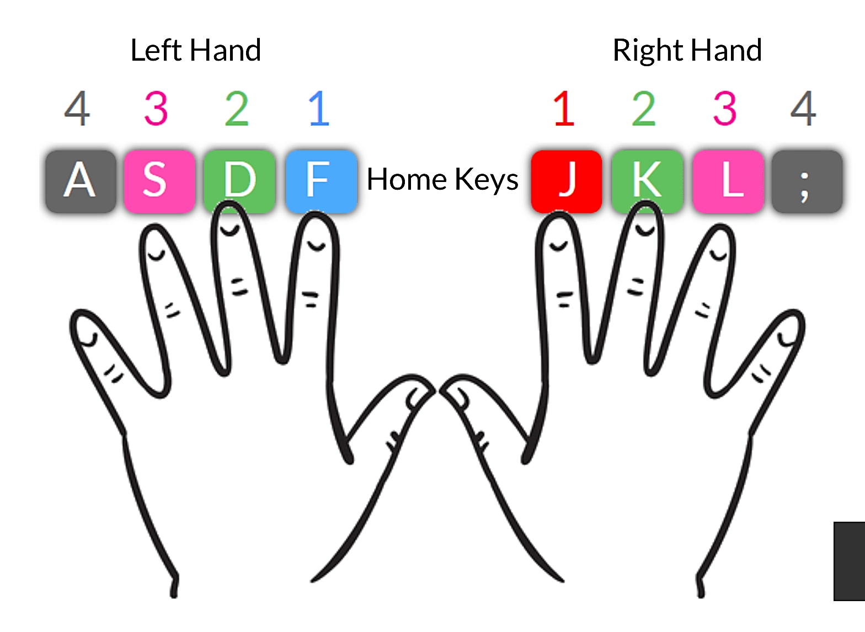
Correct Finger Positions
Home Row Keys (starting position)
Fingers rest on the middle row of the keyboard — called the home row:
Left hand: A, S, D, F
Right hand: J, K, L, ;
Both thumbs rest lightly on the spacebar.
Raised bump on the F and J keys.

Slide 24
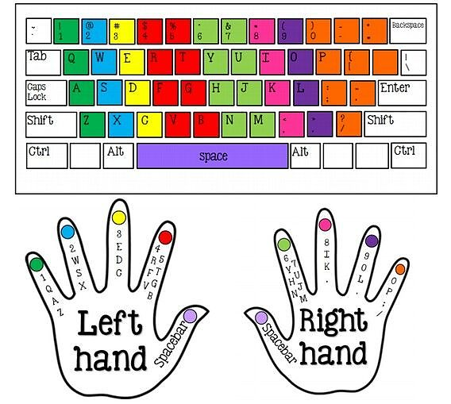
Finger-wise Key Allocation
Finger Used | Left Hand Keys | Right Hand Keys
Pinky (Little finger) | 1, Q, A, Z | 0, P, ; (semicolon), / (slash)
Ring finger | 2, W, S, X | 9, O, L, . (period)
Middle finger | 3, E, D, C | 8, I, K, , (comma)
Index finger | 4, 5, R, T, F, G, V, B | 6, 7, Y, U, H, J, N, M
Thumb | Spacebar | Spacebar

Slide 25

Module 2: Power On

Slide 26
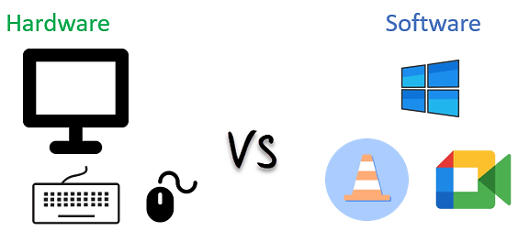
Hardware and Software
Point | Hardware | Software
What is it? | Parts of a computer you can touch | Programs inside the computer
Examples | Keyboard, Monitor, CPU | Notepad, Games, Windows
Can you touch it? | Yes | No
Use | Helps run the computer | Tells the computer what to do
Software
System Software (Windows, macOs)
Application Software (MS Word, Notepad)

Slide 27

Identifying Buttons and Slots
Touch the front of the UPS and CPU to find the Power On button (usually bigger).
Explore buttons on:
CPU
Monitor
Speakers
Locate and identify:
USB ports
SD card slot

Slide 28

Power On : Haptic Feedback
Press Power On of a laptop/desktop.
Place palm on CPU or laptop base.
Feel vibrations or airflow (fan noise).
Press CD drive eject (if available). No response = not powered on.
Wait for screen reader announcement (booting complete).
If not heard, press Ctrl + Windows + Enter to start Narrator.
Sample output: "Windows sign-in, [Time], [date]"

Slide 29


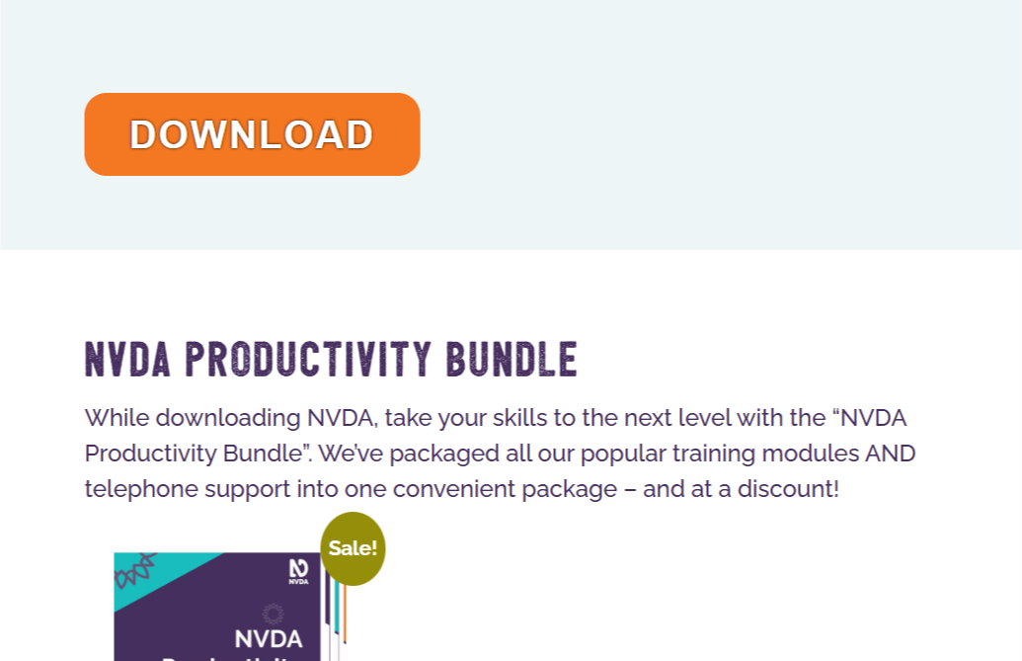
Install NVDA
Scroll Down
02
Go to Website
04
Install NVDA file
03
Download File
01
Search on Google
Click Here
Click Here

Slide 30
Run NVDA
How to Run NVDA
How to Turn off NVDA
Method 1: Using the Keyboard Shortcut
Press Insert + Q or CapsLock + Q (Insert is usually the NVDA key by default)
NVDA will say: "Do you want to quit NVDA?"
Press Enter to confirm.
Method 2: Using the NVDA Menu
Press Insert + N to open the NVDA menu.
Use the arrow keys to go to "Exit".
Press Enter.
If NVDA is already installed on your computer:
Method 1: Press the shortcut key:
Ctrl + Alt + N
This is the default shortcut for launching NVDA.
Method 2: open it manually:
Press the Windows key.
Type NVDA in the search box.
Press Enter when NVDA appears in the results.

Slide 31
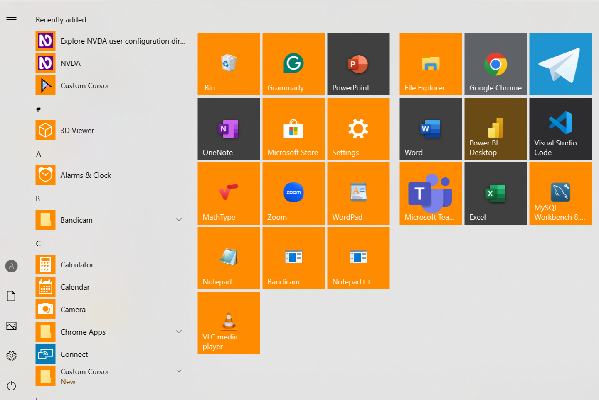
How to Open App
Press the Windows key on your keyboard.
Type the name of the app (for example: “Notepad” or “Calculator”).
Press Enter when you hear the correct app name.

Slide 32
Thank You

